Slide 1
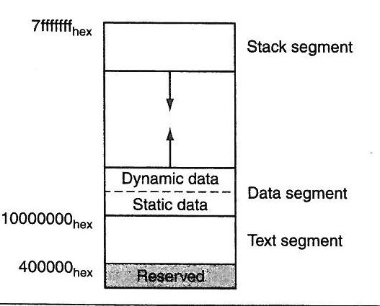
Chapter 5: Memory Systems
Why do we need memory?
Stored program computers: Both the executable code and data are in memory
What constitutes as memory? Disk, Flash memory, DRAMs, SRAMs, Caches
I-Cache
D-Cache
CPU
Virtual Memory
Physical Memory (DRAM)

Slide 2
Advanced DRAM Organization
Bits in a DRAM are organized as a rectangular array
DRAM accesses an entire row
Burst mode: supply successive words from a row with reduced latency
Double data rate (DDR) DRAM
Transfer on rising and falling clock edges
Quad data rate (QDR) DRAM
Separate DDR inputs and outputs

Slide 3
DRAM Generations
Year | Capacity | $/GB
1980 | 64Kbit | $1500000
1983 | 256Kbit | $500000
1985 | 1Mbit | $200000
1989 | 4Mbit | $50000
1992 | 16Mbit | $15000
1996 | 64Mbit | $10000
1998 | 128Mbit | $4000
2000 | 256Mbit | $1000
2004 | 512Mbit | $250
2007 | 1Gbit | $50
Access Time to new row
Access Time to existing row

Slide 4
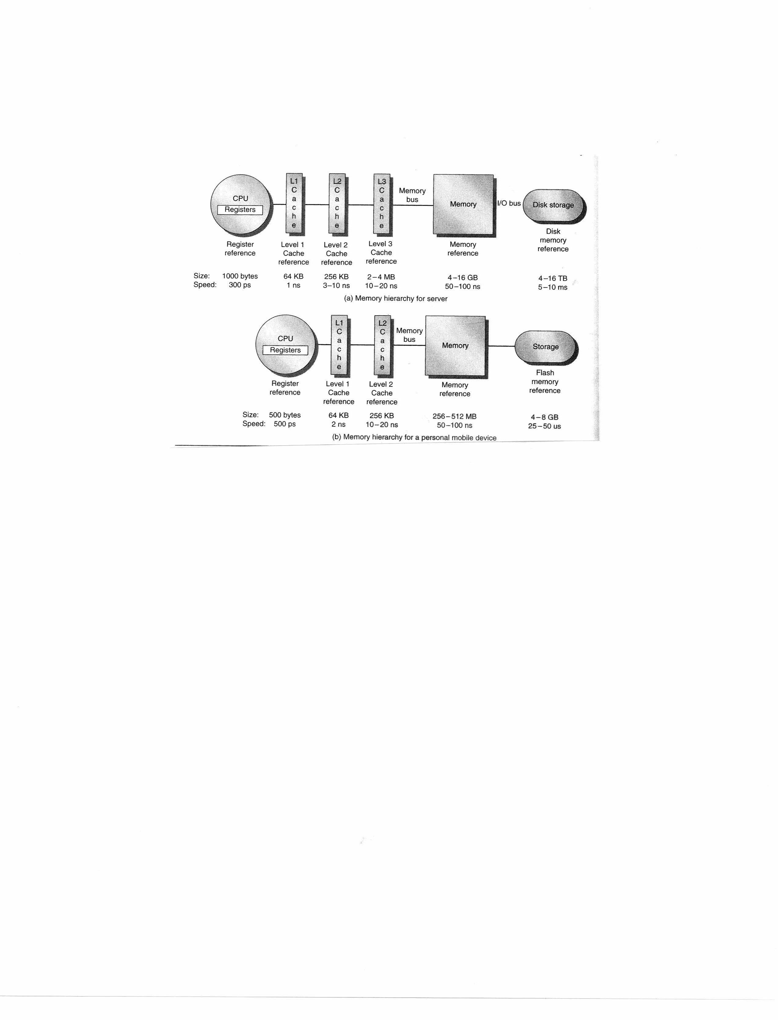
Memory Hierarchy

Slide 5
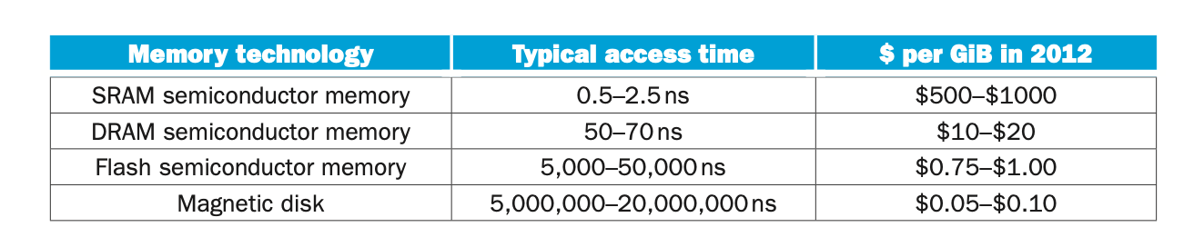
Memory Type – Speed and Cost

Slide 6
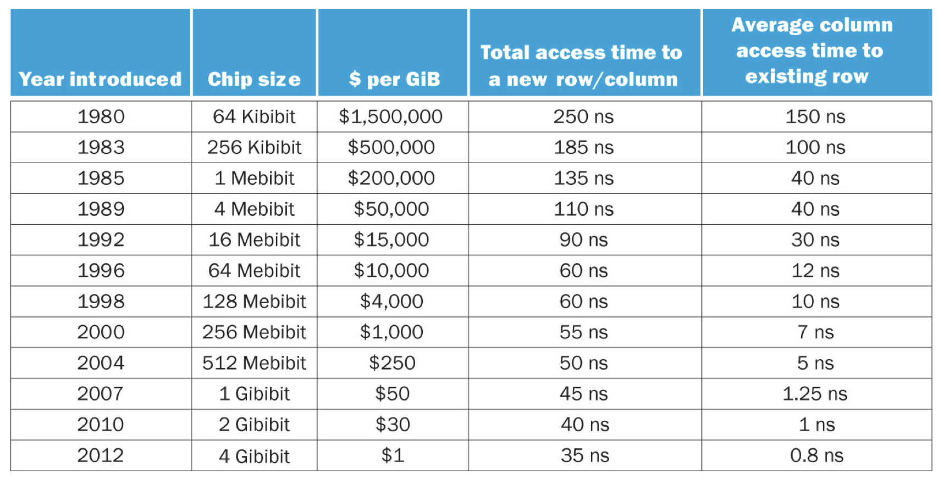
Memory Type – Speed and Cost

Slide 7
Types of computer memory
Cache memory. This temporary storage area is more readily available to the processor than the computer's main memory source. Typically integrated directly into the CPU chip or placed on a separate chip with a bus interconnect with the CPU.
Dynamic RAM. DRAM is a type of semiconductor memory that is typically used by the data or program code needed by a computer processor to function. Needs to be refreshed periodically
Static RAM. SRAM retains data bits in its memory for as long as power is supplied to it. SRAM does not have to be periodically refreshed.

Slide 8
When memory access matters
for (row = 0 to 10)
for (col = 0 to 10) // loop through cols before going to the next row
sum += a[row][col] (0,0), (0,1), (0,2), (0,3),,,,, (0,8), (0,9)
(1,0), (1,1), (1,2), (1,3),,,,, (1,9), (1,9)
(9,0), (9,1), (9,2), (9,3),,,,, (9,9), (9,9)
Reads bytes 0,1,2,3,4,5,6,7,8,9 first. Reads consecutive bytes
for (col = 0 to 10)
for (row = 0 to 10) // loop through rows before going to the next col
sum += a[row][col] (0,0), (1,0), (2,0), (3,0),,,,, (8,0), (9,0)
(0,1), (1,1), (2,1), (3,1),,,,, (8,1), (9,1)
(0,9), (1,9), (2,9), (3,9),,,,, (8,9), (9,9)
Reads bytes 10, 20, 30, 40, 50, 60, 70, 80, 90 first.
Skipping 10 bytes at a time

Slide 9
Think of the (row, col) as addresses
(r,c) | 0 | 1 | 2 | 3 | 4 | 5 | 6 | 7 | 8 | 9
0 | 0,0 | 0,1 | 0,2 | 0,3 | 0,4 | 0,5 | 0,6 | 0,7 | 0,8 | 0,9
1 | 1,0
2 | 2,0
3 | 3,0
4 | 4,0
5 | 5,0
6 | 6,0
7 | 7,0
8 | 8,0
9 | 9,0 |  |  |  |  |  |  |  |  | 9,9
All these words on in the same block
Each of these words are in different blocks

Slide 10
What is the address of the data element
(r,c) | 0 | 1 | 2 | 3 | 4 | 5 | 6 | 7 | 8 | 9
0 | 0 | 1 | 2 | 3 | 4 | 5 | 6 | 7 | 8 | 9
1 | 10 | 11 | 12 | 13
2 | 20
3 | 30
4 | 40
5 | 50
6 | 60
7 | 70
8 | 80
9 | 90 | 91 | 92 | 93 | 94 | 95 | 96 | 97 | 98 | 99
All these words on in the same block
Each of these words are in different blocks

Slide 11
ABC’s of Caches
How is cache memory organized -- (caches are very small)
Consider a 64-bit address. And we have only 64K Byte cache
or 16-bits to address any byte in cache
How do we translate the 64-bit (physical/virtual) address to 16-bit cache address?
64-bit address (virtual or physical)
16-bit cache address
Cache memories are organized as blocks and each block has 2^{m} bytes
For example, 16 byte block (m=4), 32 (m=5), 64 (m=6) or 128 (m=7) byte blocks
We need m bits to find a byte within a block
If there are 2^{n} blocks (each containing 2^{m} bytes) = total size of cache = 2^{n+m}
We need n bits to find a block = n block index bits

Slide 12
Blocks of Memory
Page 000 00 000 01 000 10 000 11
100 00 100 01 100 10 100 11
0
1
2
3
0
1
2
3
0
1
2
3
0
1
2
3
0
1
2
3
0
1
2
3
0
1
2
3
0
1
2
3
4
5
6
7
4
5
6
7
4
5
6
7
4
5
6
7
4
5
6
7
4
5
6
7
4
5
6
7
4
5
6
7
8
9
A
B
8
9
A
B
8
9
A
B
8
9
A
B
8
9
A
B
8
9
A
B
8
9
A
B
8
9
A
B
C
D
E
F
C
D
E
F
C
D
E
F
C
D
E
F
C
D
E
F
C
D
E
F
C
D
E
F
C
D
E
F
Page 001 00 001 01 001 10 001 11
101 00 101 01 101 10 101 11
0
1
2
3
0
1
2
3
0
1
2
3
0
1
2
3
0
1
2
3
0
1
2
3
0
1
2
3
0
1
2
3
4
5
6
7
4
5
6
7
4
5
6
7
4
5
6
7
4
5
6
7
4
5
6
7
4
5
6
7
4
5
6
7
8
9
A
B
8
9
A
B
8
9
A
B
8
9
A
B
8
9
A
B
8
9
A
B
8
9
A
B
8
9
A
B
C
D
E
F
C
D
E
F
C
D
E
F
C
D
E
F
C
D
E
F
C
D
E
F
C
D
E
F
C
D
E
F
Page 010 00 010 01 010 10 010 11
110 00 110 01 110 10 110 11
0
1
2
3
0
1
2
3
0
1
2
3
0
1
2
3
0
1
2
3
0
1
2
3
0
1
2
3
0
1
2
3
4
5
6
7
4
5
6
7
4
5
6
7
4
5
6
7
4
5
6
7
4
5
6
7
4
5
6
7
4
5
6
7
8
9
A
B
8
9
A
B
8
9
A
B
8
9
A
B
8
9
A
B
8
9
A
B
8
9
A
B
8
9
A
B
C
D
E
F
C
D
E
F
C
D
E
F
C
D
E
F
C
D
E
F
C
D
E
F
C
D
E
F
C
D
E
F
Page 011 00 011 01 011 10 011 11
111 00 111 01 111 10 111 11
0
1
2
3
0
1
2
3
0
1
2
3
0
1
2
3
0
1
2
3
0
1
2
3
0
1
2
3
0
1
2
3
4
5
6
7
4
5
6
7
4
5
6
7
4
5
6
7
4
5
6
7
4
5
6
7
4
5
6
7
4
5
6
7
8
9
A
B
8
9
A
B
8
9
A
B
8
9
A
B
8
9
A
B
8
9
A
B
8
9
A
B
8
9
A
B
C
D
E
F
C
D
E
F
C
D
E
F
C
D
E
F
C
D
E
F
C
D
E
F
C
D
E
F
C
D
E
F
The address of the purple A is 010 10 1010 XX XXXX XXXX
Tag index Offset in block
Application Memory is much larger
Each Page holds 16K bytes
There are 32 pages of data memory. 16K x 32 = 512K
But how big is the cache?

Slide 13
Memory
Page 000 00 000 01 000 10 000 11
010 10
0
1
2
3
0
1
2
3
0
1
2
3
0
1
2
3
4
5
6
7
4
5
6
7
4
5
6
7
4
5
6
7
0
1
2
3
8
9
A
B
8
9
A
B
8
9
A
B
8
9
A
B
C
D
E
F
C
D
E
F
C
D
E
F
C
D
E
F
Page 001 00 001 01 001 10 001 01
4
5
6
7
0
1
2
3
0
1
2
3
0
1
2
3
0
1
2
3
4
5
6
7
4
5
6
7
4
5
6
7
4
5
6
7
8
9
A
B
8
9
A
B
8
9
A
B
8
9
A
B
8
9
A
B
C
D
E
F
C
D
E
F
C
D
E
F
C
D
E
F
Page 010 00 010 01 010 10 010 11
C
D
E
F
0
1
2
3
0
1
2
3
0
1
2
3
0
1
2
3
4
5
6
7
4
5
6
7
4
5
6
7
4
5
6
7
8
9
A
B
8
9
A
B
8
9
A
B
8
9
A
B
000 Tag 10 Index
C
D
E
F
C
D
E
F
C
D
E
F
C
D
E
F
Page 011 00 011 01 011 10 011 11
0
1
2
3
0
1
2
3
0
1
2
3
0
1
2
3
4
5
6
7
4
5
6
7
4
5
6
7
4
5
6
7
8
9
A
B
8
9
A
B
8
9
A
B
8
9
A
B
C
D
E
F
C
D
E
F
C
D
E
F
C
D
E
F
The Index is where the block will be copied to when it moves to the Cache
Block A represents addresses between
010 10 1010 00 0000 0000
010 10 1010 11 1111 1111

Slide 14
Cache
Block 00 01 10 11
0
1
2
3
0
1
2
3
0
1
2
3
0
1
2
3
4
5
6
7
4
5
6
7
4
5
6
7
4
5
6
7
8
9
A
B
8
9
A
B
8
9
A
B
8
9
A
B
C
D
E
F
C
D
E
F
C
D
E
F
C
D
E
F
Our Cache has 4 Blocks.
Number: 00 01 10 11
Each block has 16K bytes
Total Cache size is 4 * 16K = 64K bytes
But our application has 512K!!

Slide 15
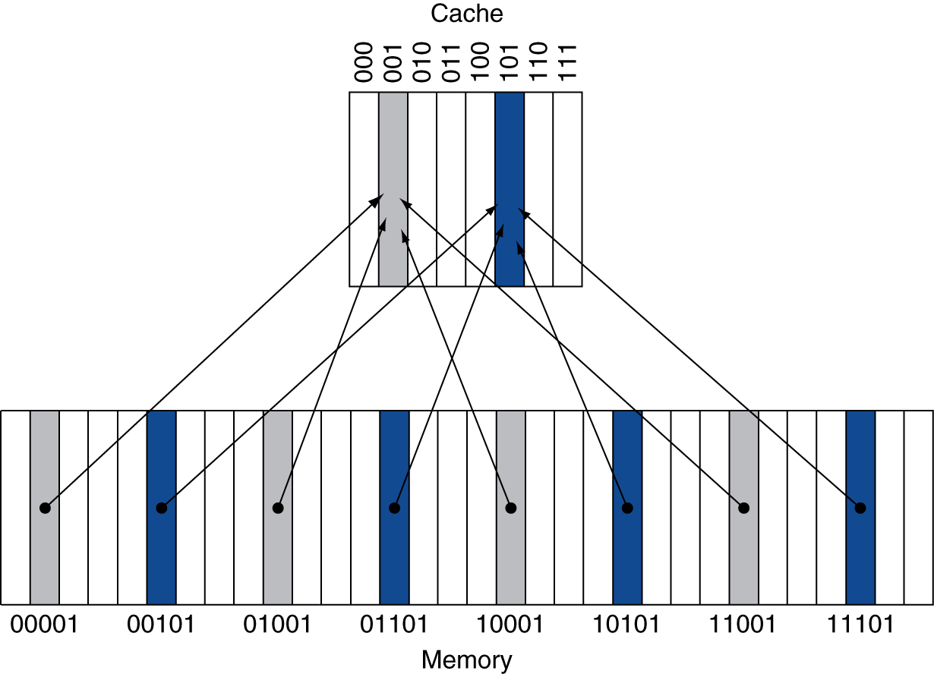
Direct Mapped Cache – a simple example
Location determined by address
Direct mapped: only one choice (Associativity = 1)
(Block address) modulo (#Blocks in cache) → Modulo arithmetic
#Blocks is a power of 2
Use low-order address bits
In this example we have 8 cache blocks and 32 memory blocks
That means 4 different memory blocks compete for the same cache location
Only 1 of 4 can be in cache at any time
Physical Address Cache block
00 001 XXXX
01 001 XXXX
10 001 XXXX 001
11 001 XXXX

Slide 16
Memory
Page 000 00 000 01 000 10 000 11
010 10
0
1
2
3
0
1
2
3
0
1
2
3
0
1
2
3
4
5
6
7
4
5
6
7
4
5
6
7
4
5
6
7
0
1
2
3
8
9
A
B
8
9
A
B
8
9
A
B
8
9
A
B
C
D
E
F
C
D
E
F
C
D
E
F
C
D
E
F
Page 001 00 001 01 001 10 001 01
4
5
6
7
0
1
2
3
0
1
2
3
0
1
2
3
0
1
2
3
4
5
6
7
4
5
6
7
4
5
6
7
4
5
6
7
8
9
A
B
8
9
A
B
8
9
A
B
8
9
A
B
8
9
A
B
C
D
E
F
C
D
E
F
C
D
E
F
C
D
E
F
Page 010 00 010 01 010 10 010 11
C
D
E
F
0
1
2
3
0
1
2
3
0
1
2
3
0
1
2
3
4
5
6
7
4
5
6
7
4
5
6
7
4
5
6
7
8
9
A
B
8
9
A
B
8
9
A
B
8
9
A
B
010 Tag 10 Index
C
D
E
F
C
D
E
F
C
D
E
F
C
D
E
F
Page 011 00 011 01 011 10 011 11
0
1
2
3
0
1
2
3
0
1
2
3
0
1
2
3
4
5
6
7
4
5
6
7
4
5
6
7
4
5
6
7
8
9
A
B
8
9
A
B
8
9
A
B
8
9
A
B
C
D
E
F
C
D
E
F
C
D
E
F
C
D
E
F
Notice that the Page number has 5 bits 3 for the tag and 2 for the index
There are 4 blocks with an index of 10 But the first 3 btis are all unique 000 to 111

Slide 17
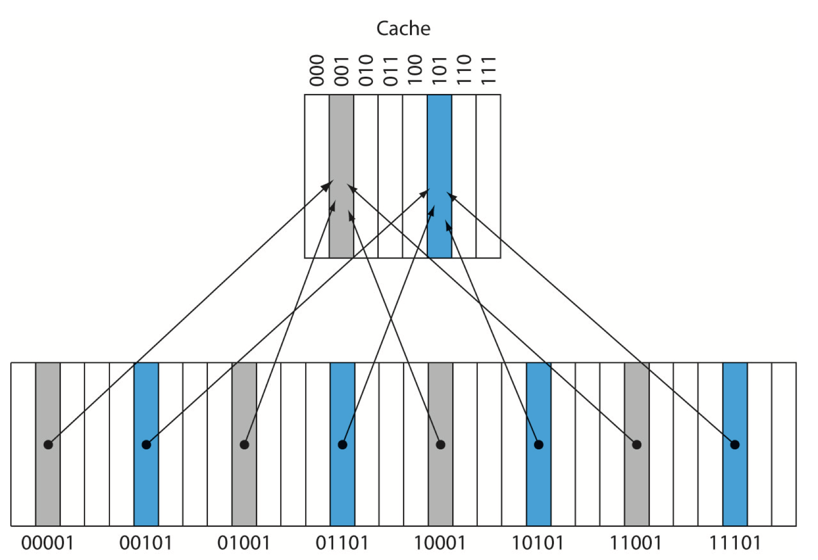

Slide 19
Tags and Valid Bits
How do we know which block is stored in a cache location?
Store a part of the block address as well as the data
Called the tag
What if there is no data in a location?
(random zeros and ones)
Valid bit:
1 = present, 0 = not present
An example: 8 blocks each block = 4 bytes
Index = cache location address
Actual size of the cache = (data size) +Tag size + 1 (valid bit)
Index | V | Tag | Data
000 | N
001 | N
010 | N
011 | N
100 | N
101 | N
110 | N
111 | N

Slide 20
Cache Example
Word addr | Binary addr | Hit/miss | Cache block
22 | 10 110 | Miss | 110
Index | V | Tag | Data
000 | N
001 | N
010 | N
011 | N
100 | N
101 | N
110 | Y | 10 | Mem[10110] (data at 10110)
111 | N
Initially cache is empty (valid bits =0). So we bring the data from memory at address “22” and store in cache block 110 . We set the tag to 10 (from the address), set valid bit to 1

Slide 21
Cache Example
Word addr | Binary addr | Hit/miss | Cache block
22 | 10 110 | Hit | 110
26 | 11 010 | Miss | 010
Index | V | Tag | Data
000 | N
001 | N
010 | Y | 11 | Mem[11010]
011 | N
100 | N
101 | N
110 | Y | 10 | Mem[10110]
111 | N
Read address “11010” : Is index 010 valid?
No! So bring it in from memory
Set tag to 11 (from the address), set valid bit to 1

Slide 22
Cache Example
Binary addr | Hit/miss | Cache block
10 110 | Hit | 110
11 010 | Hit | 010
10 010 | Miss | 010
Same Index but the TAGs are different
Index | V | Tag | Data
000 | N
001 | N
010 | Y | 11 | Mem[11010]
011 | N
100 | N
101 | N
110 | Y | 10 | Mem[10110]
111 | N
Read address “10010” : Is index 010 valid? Yes!
Does the TAG match? NO!
Read block 10010 from memory into the cache
Set tag to 11 (from the address), set valid bit to 1

Slide 23
Cache Example
Word addr | Binary addr | Hit/miss | Cache block
22 | 10 110 | Hit | 110
26 | 11 010 | Hit | 010
18 | 10 010 | Miss | 010
Index | V | Tag | Data
000 | N
001 | N
010 | Y | 10 | Mem[10010]
011 | N
100 | N
101 | N
110 | Y | 10 | Mem[10110]
111 | N

Slide 24
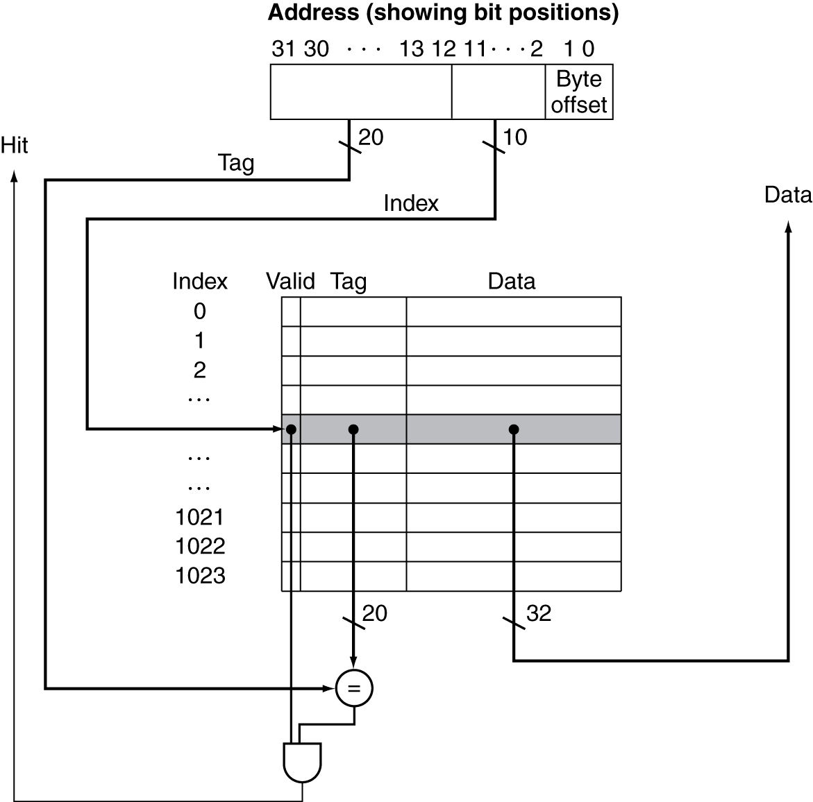
Address Subdivision – Apr 16 start

Slide 25
Bigger cache blocks
Consider an example with 64 byte blocks or
Blocks In 64K Byte cache we will have 1024 cache blocks (each with 64 bytes)
A straightforward address translation looks like
16-bit block ID (or tag)
10-bit Cache block address
6-bit byte address
(offset in block)
Tags of data currently in Cache
Data in Cache (64 bytes per block)
This type of cache is called a DIRECT mapped cache
A given address can only be placed in a specific cache block
→ here we are looking at 32-bit address.

Slide 26
An example → address is 32 bits
Tag 16 bits Block 10 bits Byte in block 6 bits
Let us assume that the data at the addresses below look like
(B01A A050) (B01A A073) (B2FE 3057) (B01B A04E)
Where will they fall if we have direct mapped cache with 64K cache
64 Byte cache blocks 1024 blocks
Tag (641) (16)
B01A A050 = 1010000001 010000 Block 641, byte 16
on first access, it is a miss. We bring 64 bytes including
16th byte and 51st
Tag (641) (51)
B01A A073 = 1010000001 110011 Block 641, byte 51 (hit)
Same Index and the same Tag! So byte 51 is already in memory
Tag (191) (23)
B2FE 3057 = 0011000001 010111 Block 191, byte 23 (cold miss)
bring 64 bytes including 23rd byte
Tag (641) (14)
B01B A04E = 1010000001 001110 Block 641 Byte 14 (conflict miss)
Index matches BUT the Tag does not
evict previous data (16th byte and 51st byte,
bring new 64 bytes including 14th byte

Slide 27
What is the total cache size?
Remember cache contains
Actual data Data size = (#bytes per block * 8) * (#blocks)
For each cache block, we also store
Tag TAG size = (#bits of tag per block) * (#blocks)
Valid bit Valid size = 1 * (#blocks)
Example: 32KB cache, with 16-byte cache blocks (4 bits offest)
Number of Cache blocks = 2048 = (32KB / 16B) (11 bit cache index)
Each Cache block needs the associated tag 32 – 11 – 4 = 17 bits for tag
1 cache block needs (16 x 8) + 17 + 1. Data bits + tag bits + valid bit
128 + 17 + 1 = 146 for each cache block
146 * 2048 = 299,008 bits for cache

Slide 28
What is the total cache size?
TAG =17 bits
Index =11 bits
Byte offset = 4 bits
The 32-bit address is divided as shown.
So, we need to store 17-bit tag with each cache block plus the Valid bit
Each cache entry = 17 (Tag) +1 (Valid) +128 (data) = 146 bits
There are 2048 blocks. Total size = 2048*146 = 299,008 bits
The data size = 2048*128 = 262,144 bits (or 32KB)
Overhead = 36,864 bits or 14% (17 + 1) / 128
TAG = 17 bits
V bit
DATA = 16 bytes x 8 = 128 bits
V bit

Slide 29
Locality behavior
Caches are useful because of a phenomenon known as “locality”
Two types of localities
Spatial Locality Nearby data will be needed soon
Instructions, Arrays, streams
Temporal Locality: The same data is likely to be used again in near future
Index variables
Instructions inside a loop
This is another reason for using separate Instruction and Data cache
We can design them differently to benefit for these different types of locality
Spatial locality benefits from large cache blocks (64 or 128 bytes)
Temporal locality benefits from smaller blocks by higher associativity.

Slide 30
temporal locality The locality principle stating that if a data location is referenced then it will tend to be referenced again soon.
Spatial locality The locality principle stating that if a data location is referenced, data locations with nearby addresses will tend to be referenced soon.

Slide 31
Cache size
Tag | Block bits n # of bits | # of Blocks 2^{n} blocks | Byte bits n # of bits | Bytes / Block 2^{n} bytes | Cache Size
18=32-4-10 | 4 | 2⁴ = 16 | 10 | 2¹⁰ = 1024 | 16K
16 | 8 | 256 | 8 | 256 | 64K
17 | 10 | 1024 | 5 | 32 | 32K
17 | 11 | 2048 | 4 | 16 | 32K
20 | 10 | 1024 | 2 | 4 | 4K

Slide 32
block (or line) The minimum unit of information that can be either present or not present in a cache.
hit rate The fraction of memory accesses found in a level of the memory hierarchy.
miss rate The fraction of memory accesses not found in a level of the memory hierarchy.
hit time The time required to access a level of the memory hierarchy, including the time needed to determine whether the access is a hit or a miss.
miss penalty The time required to fetch a block into a level of the memory hierarchy from the lower level, including the time to access the block, transmit it from one level to the other, insert it in the level that experienced the miss, and then pass the block to the requestor.

Slide 33
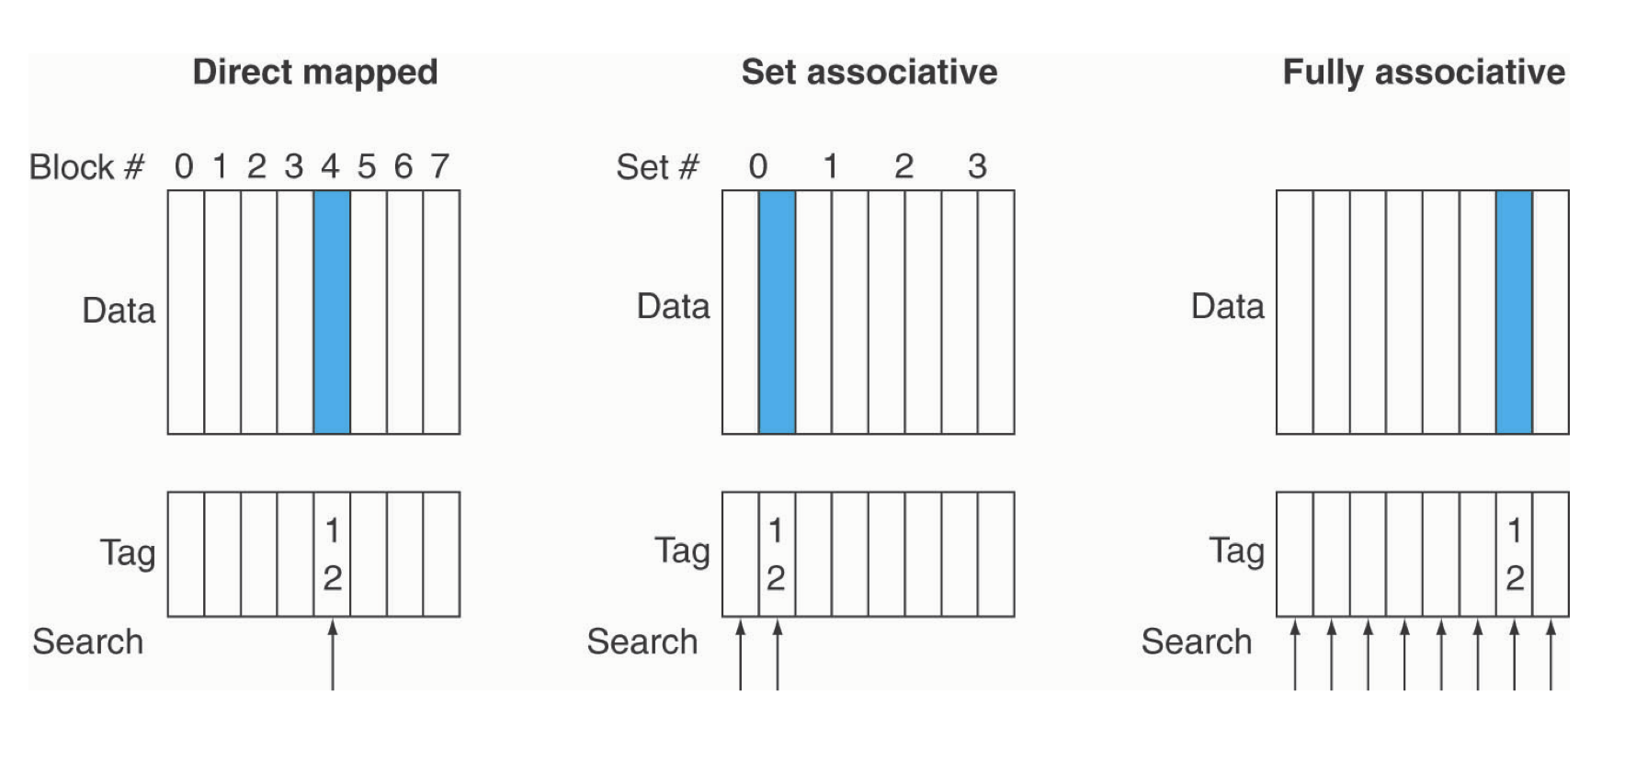

Slide 34
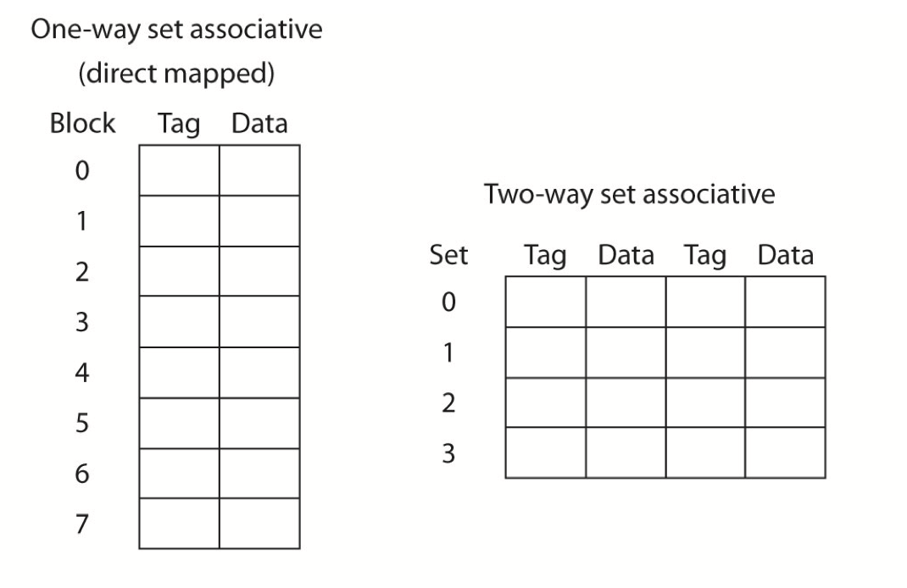

Slide 35
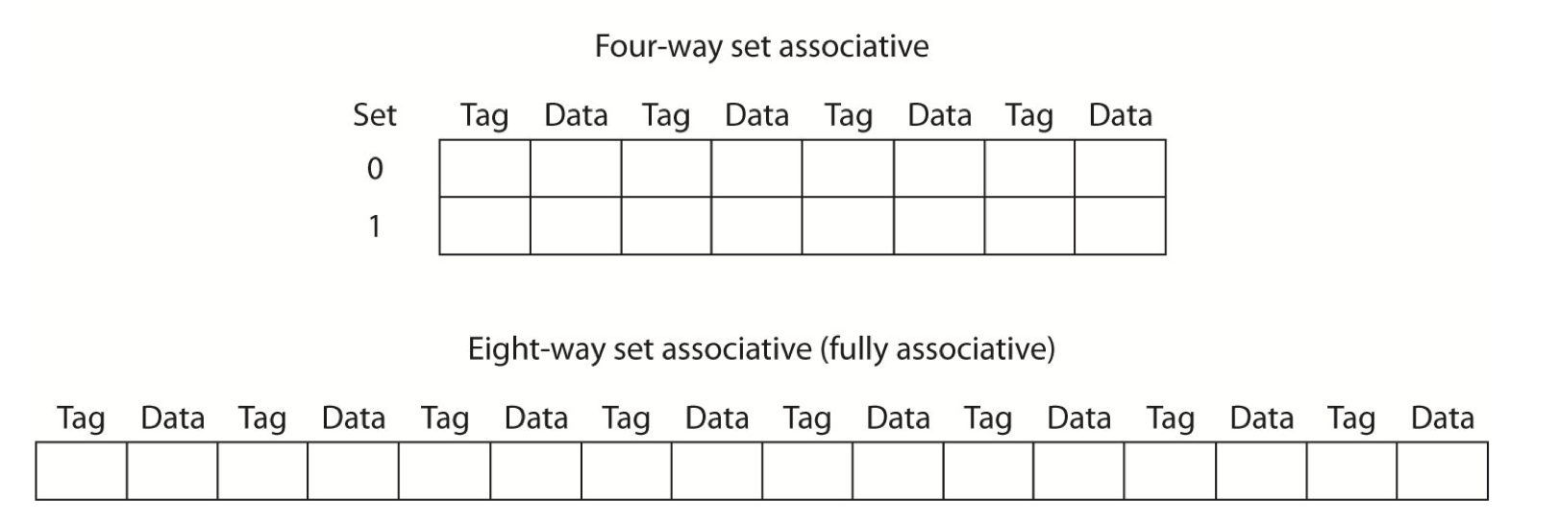

Slide 36
What is the total cache size?
TAG =18 bits
Index =10 bits
Byte offset =4 bits
If we have 2 way associative cache, still 32KB cache. We now have only 1024 sets
We need 10 bits for index and Tag becomes 18 bits
TAG = 18 bits
V bit
DATA = 16 x 8 = 128 bits
V bit
Each cache entry = 18 (Tag) +1 (Valid) +128 (data) = 147 bits
There are 2048 lines. Total size = 2048*147 = 301,056 bits
The data size = 2048*128 = 262,144 bits (or 32KB)
Overhead = 38,912 bits or 14.8%
Higher associativity → more tag bits (fewer index bits) → more overhead bits

Slide 37
What is the total cache size?
4-way set-associative: 512 sets (4 cache lines per set)
Index = 9 bits, Byte offset = 4 bits, Tag = 32 – (9+4) = 19 bits
Total cache size = (512*4) * (19+1+16*8) = 303, 104 bits
TAG =19 bits
Index =9 bits
Byte offset =4 bits
Fully associative = 1 set (2048 cache line per set)
Index = 0 bits, Byte offset = 4 bits, Tag = 32 -(0+4) = 28 bits
Total cache size = (1*2048) * (28+1+16*8) = 321, 536 bits
TAG =28 bits
Byte offset =4 bits

Slide 38
Associative Caches
Fully associative
Allow a given block to go in any cache entry
Requires all entries to be searched at once
Comparator per entry (expensive)
n-way set associative
Each set contains n entries
Block number determines which set
(Block number) modulo (#Sets in cache)
Search all entries in a given set at once
n comparators (less expensive)

Slide 39
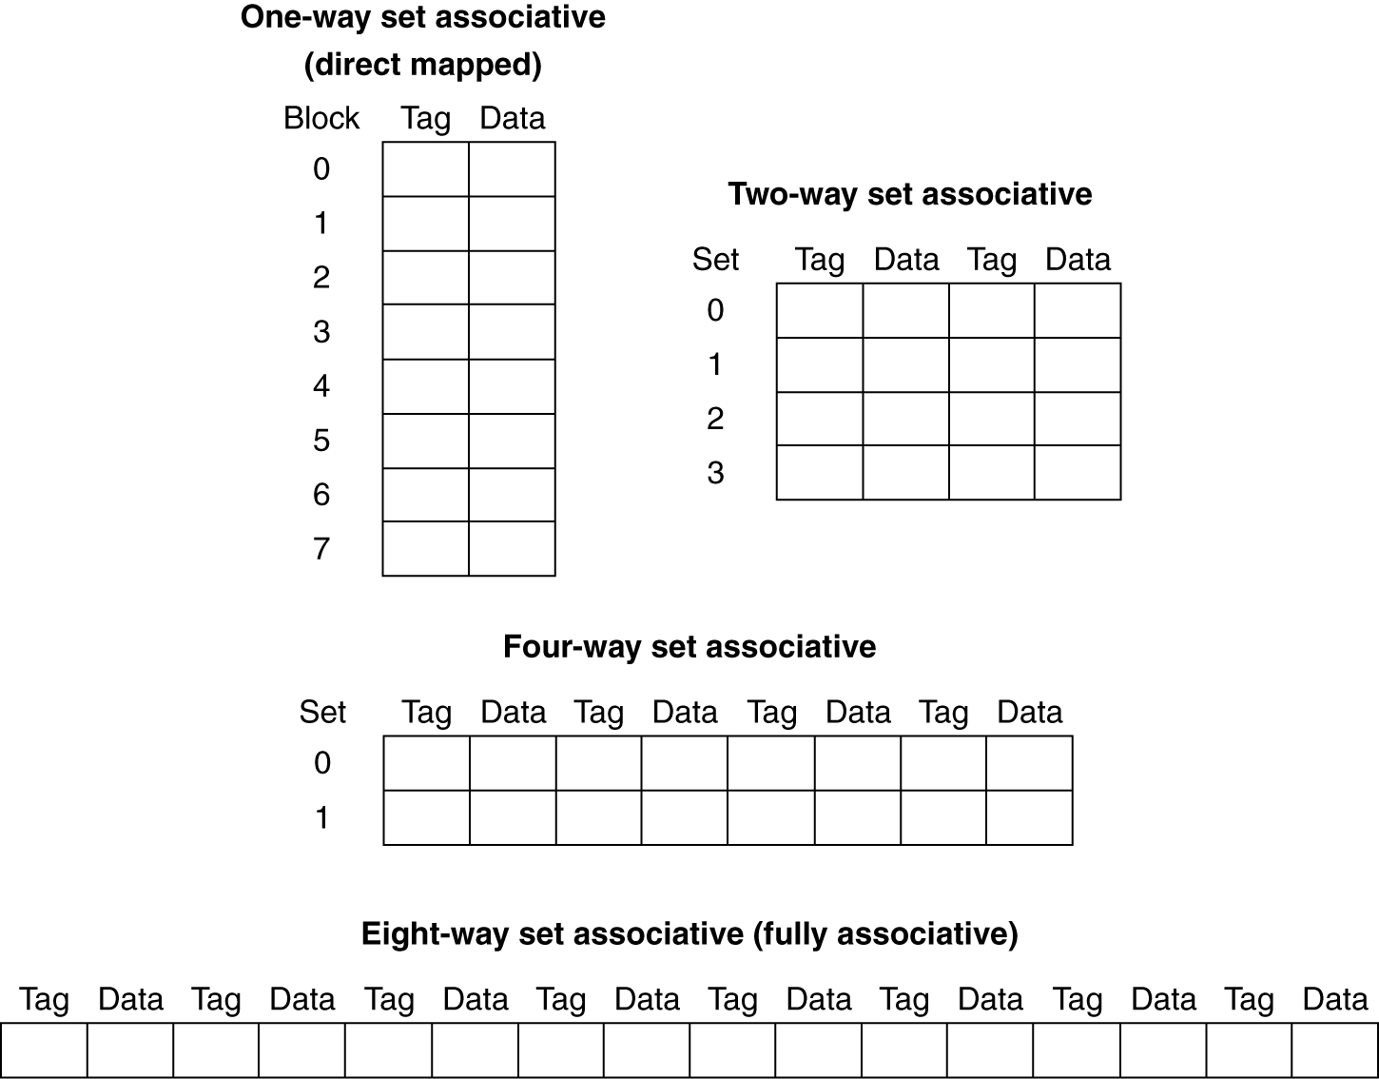
Spectrum of Associativity
For a cache with 8 entries

Slide 40
Associativity Example
Compare 4-block caches
Direct mapped, 2-way set associative, fully associative
Block access sequence: 0, 8, 0, 6, 8
Direct mapped
Block address | Cache index | Hit/miss | Cache content after access
 |  |  | 0 | 1 | 2 | 3
0 | 0 | miss | Mem[0]
8 | 0 | miss | Mem[8]
0 | 0 | miss | Mem[0]
6 | 2 | miss | Mem[0] |  | Mem[6]
8 | 0 | miss | Mem[8] |  | Mem[6]

Slide 41
Associativity Example
2-way set associative
Block address | Cache index | Hit/miss | Cache content after access
 |  |  | Set 0 |  | Set 1
0 | 0 | miss | Mem[0]
8 | 0 | miss | Mem[0] | Mem[8]
0 | 0 | hit | Mem[0] | Mem[8]
6 | 0 | miss | Mem[0] | Mem[6]
8 | 0 | miss | Mem[8] | Mem[6]
Fully associative
Block address |  | Hit/miss | Cache content after access
0 |  | miss | Mem[0]
8 |  | miss | Mem[0] | Mem[8]
0 |  | hit | Mem[0] | Mem[8]
6 |  | miss | Mem[0] | Mem[8] | Mem[6]
8 |  | hit | Mem[0] | Mem[8] | Mem[6]

Slide 42
Performance due to cache
A perfect cache means, you will find all instructions and data in cache → no misses
Given
Instr-cache miss rate = 2% → 2% of instructions not found in instruction cache
Data-cache miss rate = 4%
Miss penalty = 100 cycles (it takes 100 cycles to get data into cache)
Base CPI (ideal cache) = 1
Load & stores are 36% of instructions
Miss cycles per instruction
I-cache: 2% × 100 = 2 2% of the time we take 1 100 cycle hit
D-cache: 36% × 4% × 100 = 1.44
Actual CPI = 1 + 2 + 1.44 = 4.44
Ideal CPU is 4.44/1 =4.44 times faster (or real cache is slower)
Average Memory Access Time → how long it takes to get data/instructions from memory
(access time on cache hit) * (hit rate) + (miss rate) * (miss penalty)
hit rate = 1-(miss rate)

Slide 43
Cache Performance Example
Given
I-cache miss rate = 2%
D-cache miss rate = 4%
Miss penalty = 100 cycles
Base CPI (ideal cache) = 2
Load & stores are 36% of instructions
Miss cycles per instruction
I-cache: 0.02 × 100 = 2
D-cache: 0.36 × 0.04 × 100 = 1.44
Actual CPI = 2 + 2 + 1.44 = 5.44
Ideal CPU is 5.44/2 =2.72 times faster

Slide 44
Average Access Time
Hit time is also important for performance
Average memory access time (AMAT)
AMAT = Hit time + Miss rate × Miss penalty
Example
CPU with 1ns clock, hit time = 1 cycle, miss penalty = 20 cycles, I-cache miss rate = 5%
AMAT = 1 + 0.05 × 20 = 2ns
2 cycles per instruction

Slide 45
Reading vs Writing
To read: locate the cache block and read the block (and use the needed byte)
If not in cache, “cache miss”
You can fetch data and Tag together and ignore data if tag matches
To write: We need to fetch tag, check if a hit, only then write data
So write is slower than read
Should we update higher level caches and main-memory also?
Write through vs Write back
Write through: also update memory (if you have L2, L3, update them also)
But makes writes take longer
e.g., if base CPI = 1, 10% of instructions are stores, write to memory takes 100 cycles
Effective CPI = 1 + 0.1×100 = 11 → too slow
Solution: write buffer
Holds data waiting to be written to memory
CPU continues immediately
Only stalls on write if write buffer is already full

Slide 46
Write-Through
On data-write hit, could just update the block in cache
But then cache and memory would be inconsistent
Write through: also update memory
But makes writes take longer
e.g., if base CPI = 1, 10% of instructions are stores, write to memory takes 100 cycles
Effective CPI = 1 + 0.1×100 = 11
Solution: write buffer
Holds data waiting to be written to memory
CPU continues immediately
Only stalls on write if write buffer is already full

Slide 47
Write-Back
Alternative: On data-write hit, just update the block in cache
Keep track of whether each block is dirty
When a dirty block is replaced
Write it back to memory
Can use a write buffer to allow replacing block to be read first

Slide 48
Write Allocation
What should happen on a write miss?
Alternatives for write-through
Allocate on miss: fetch the block
Write around: don’t fetch the block
Since programs often write a whole block before reading it (e.g., initialization)
For write-back
Usually fetch the block

Slide 49
Write-through vs Write back
Write-back
Alternative: Just update the block in cache (not update L2/L3 or memory)
Keep track of whether each block is dirty → we need an extra bit with each line
When a dirty block is replaced (to make room for some other data item)
Write it back to memory – (only if evicted item is dirty) → adds extra cycle(s) for this
Then bring the new data item requests
Implications on performance
Write-through may stall CPU if the write buffer is full
Must wait until the pending writes in the write buffer are stored in memory
Write-back will require that we write ”dirty evicted” cache blocks to memory
On eviction only and only if the cache block was modified
Increases miss penalty since we may have to wait longer if the evicted block is “dirty”

Slide 50
Performance of write-through
example:
Consider a CPU with a cache. You are asked to compare the performance of two choices:
write-through cache and write-back cache.
You are given the following information. 16-bytes cache blocks (or lines)
On a hit, it takes 10ns to access the cache.
On a miss, it takes 100ns to bring the missing line (16-bytes) to cache.
It takes 100ns to write one word of 32-bits (for write-through cache).
note since we only write to L1, we only write one word → 32 bits
To write a full 16-byte cache block (for write-back cache, if a dirty line is evicted), it takes 200ns.
Assume that 75% of all memory accesses are reads (that is, 25% are writes),
and on average 50% of all cache lines are dirty (needed for write-back cache design).
a). Initially we will assume that there is no write buffer with write-through. What are the access times for the two cache designs assuming that the miss rate is 1%?

Slide 51
Performance of write-through
a). For Write-through cache, each write will have to be written to memory and it will incur 100ns (no write buffer)
Read hit will take 10ns
Read miss will take 100ns (need to read entire 16 byte line)
Write on hit will take 100ns (write one word to Cache and memory)
Write on miss: need to read 16 bytes (100ns) and write one word to cache and memory (100ns)
→ 200ns
Access time on hits (on reads and writes) = 75% * 10ns + 25% * 100ns = 32.5ns
Access time on miss for read = 75%*1% * 100ns = 0.75ns
Access time on miss for write = 25%*1%*200 = 0.5ns
Effective access time = 33.75ns

Slide 52
Performance of write-back
For write-back, on a miss, if the cache line to be replaced is dirty (50% probability),
it will take 200ns to write the dirty line and 100ns to fetch the needed data.
If the cache line to be replaced is clean (50% probability) it will only take 100ns to fetch the needed data.
Access time on hit (both for read and write) = 10ns
Access time on a miss if replaced line is dirty = 1% * 50%*(200+100)ns = 1.5 ns
Access time on a miss if replaced line is clean = 1% * 50%* 100ns = .5 ns
Effective access time = 10ns + 1.5ns + 0.5ns = 12.0 ns
So, write-back is better in this case.

Slide 53
Performance of write-through
b).Assuming that we have a write buffer and that only 10% writes in a write-through cache cause the CPU to stall for the 100ns needed to write 32-bit data to memory, what is the memory access time for the write-through cache?
If we use write-buffers, not every write will incur 100ns delay – in fact only 10% of writes incur the 100ns delay. Assuming 10 ns for the 90% of the writes:
Effective access time =
75% *10ns // read hits
+ (25% * 10%) * 100ns //write hits, but write buffer is full
+ (25% * 90%) * 10ns //write hit but write buffer is free
+ 1% * 100ns // miss (either read or write)
= 7.5 ns + 2.5 ns + 2.25 ns + 1 ns
= 13.25 ns
Which is slightly slower than the write-back cache (with 12ns Average Memory Access Time)
→ remember without write buffer the access time = 33.5ns.

Slide 54
Multi-level caches
DRAM
What are the advantages of adding a second level cache?
L3
CPU
L2
L1-I
L1-D
If a miss in L1, obtain it from L2 (copied to L1)
If a miss in L2, obtain it from L3 (copied to L2 and L1)
If a miss in L3, obtain from DRAM (copied to L3, L2, L1)

Slide 55
Multi-level caches
What are the advantages of adding a second level cache?
We can reduce effective memory access time (reduce miss penalty)
Average memory access time
= (access time on L1 hit) + (L1 miss penalty)*(L1 miss rate)
= (access time on L1 hit) + (access time on L2 hit)*(L1 miss rate) +
(L2 miss penalty)*(L2 miss rate)
In other words, you are reducing the delays due to a miss in L1 → miss penalty
We can expand this to L3 cache.
L2 miss penalty = (L3 hit rate)*(L2 miss rate) + (L3 miss penalty )*(L3 miss rate)
Miss penalty → time needed to access data in the next level of memory

Slide 56
Multi-level caches
Consider the example on page 424.
Initially only L1 cache. Access time = 1 CPI at 4Ghz = 0.25ns is the cycle time
Memory access time = 100ns = miss penalty
= 400 Cycles (each CPU cycle is 0.25ns)
Cache miss rate = 2%
Access time =
(hit time in L1) + (miss rate in L1) * (miss penalty)
1 + 2% *400 = 1+ 8 = 9 cycles
Effective CPI with cache misses = 1+8 = 9 cycles

Slide 57
Memory Technology
Static RAM (SRAM)
0.5ns – 2.5ns, $100 – $500 per GB
Cache memories are designed using SRAM technology
Dynamic RAM (DRAM)
50ns – 70ns, $5 – $10 per GB
Main memory is designed using DRAM
Magnetic disk
5ms – 20ms, $0.05 – $0.2 per GB
Used for permanent storage, files etc
Generally referred to as non-volatile memories

Slide 58
Advanced DRAM Organization
Improving access time to main memories -- to reduce cache miss penalty
Consider an example of access times (these are Average times and somewhat old)
4 cycles to send address to memory
56 cycles to access a word of memory
(include, pre-charge, activate and column select)
4 cycles to send/receive the first word (4-bytes) of data
So we need 64 (= 4+56+4) cycles to read/write one word of data
If each cache line is 32 bytes (8 words)
we need 8 *(64) = 512 cycles
Effective bandwidth = 32/512 = 1/16 bytes per cycle
Latency vs Bandwidth
Latency = 64 cycles
Bandwidth = 1/16 bytes per cycle
Improving access to memory
Wide word memories
Interleaved memories

Slide 59
Concluding Remarks
§5.16 Concluding Remarks
Fast memories are small, large memories are slow
We really want fast, large memories ☹
Caching gives this illusion ☺
Principle of locality
Programs use a small part of their memory space frequently
Memory hierarchy
L1 cache ↔ L2 cache ↔ … ↔ DRAM memory ↔ disk
Memory system design is critical for multiprocessors

